Slide 1

Disparities in Access to Amenities that Promote Health and Well-Being in Washington, DC Neighborhoods:
Data Science Capstone Project
A Preliminary Exploration
Peter A. Soyka

Slide 2
Outline
Introduction/Business Problem
Data
Methods
Results
Discussion

Slide 3
Introduction/Business Problem
Washington, DC - a racially and economically diverse city and the capitol of the United States
Historically majority African-American, but demographics are changing rapidly
Many new immigrants are younger, more upwardly mobile, and more racially diverse
Geographic, racial, and economic divides:
Center and west areas – more caucasian, higher education levels and incomes, working professionals
Eastern and northeast areas – more african-American, less education, and lower incomes
Residents east of the Anacostia River (Wards 7 and 8) concerned they receive fewer city services, have higher crime rates, and have access to fewer amenities
Limited access to fresh food, drug stores, and health care facilities of particular concern

Slide 4
Study Purpose
Determine whether there are detectable differences in access to providers of goods and services that promote good health and well-being (or detract from it) across Washington, DC neighborhoods
Illustrative Provider Categories of Interest: Presumed Impact on Human Health and Well-Being
Positive | Neutral or Ambiguous | Negative
Supermarket | Convenience Store | Bar
Pharmacy/Drug Store | Military Base | Waste Facility
Bank | Warehouse | Check Cashing Facility
Spiritual Center (place of worship) | Gas Station | Prison
Athletic and Sports Facility | Recycling Facility

Slide 5
Data and Methods
Needs:
Geographic areas of DC to be studied
Political boundaries (Wards) and zip codes are too large
Neighborhoods are not defined precisely but are widely used and understood
Need names, boundaries, geographic coordinates
Categories of venues that might enhance or detract from health and well-being of neighborhood residents
Many available, some with ambiguous effects
Sources:
Zillow – data on neighborhood locations and boundaries
Foursquare database – information on venues of many types, with specific geolocation
Methods:
Operate in a Jupyter notebook, use python code to assemble and manipulate data, and apply additional libraries to perform mapping, computations, and other tasks

Slide 6
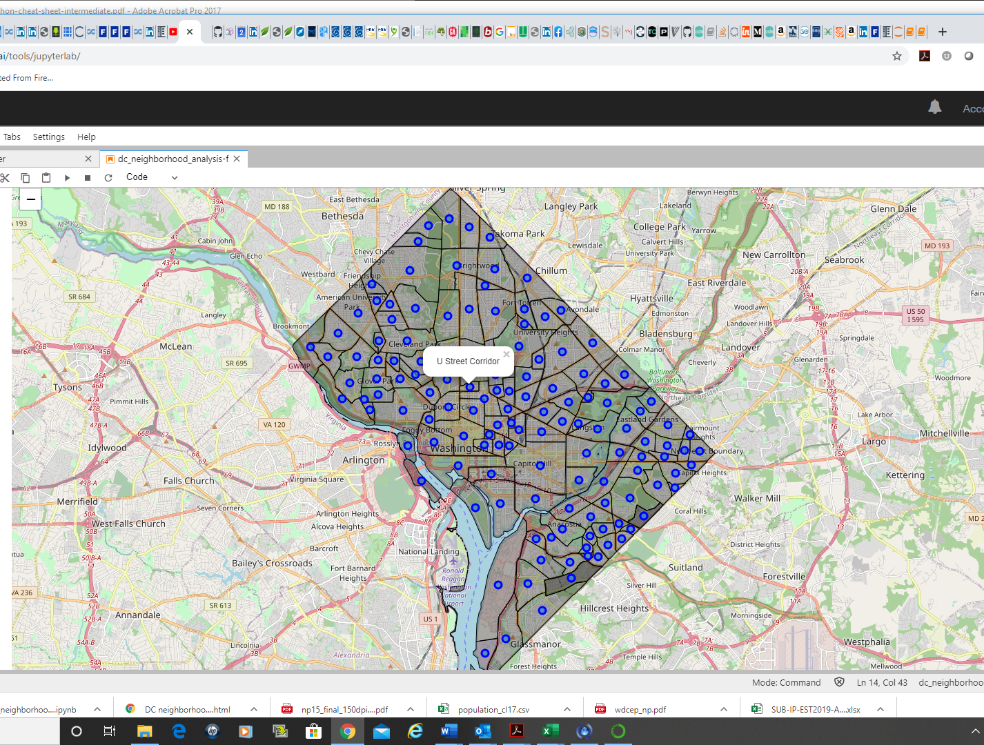
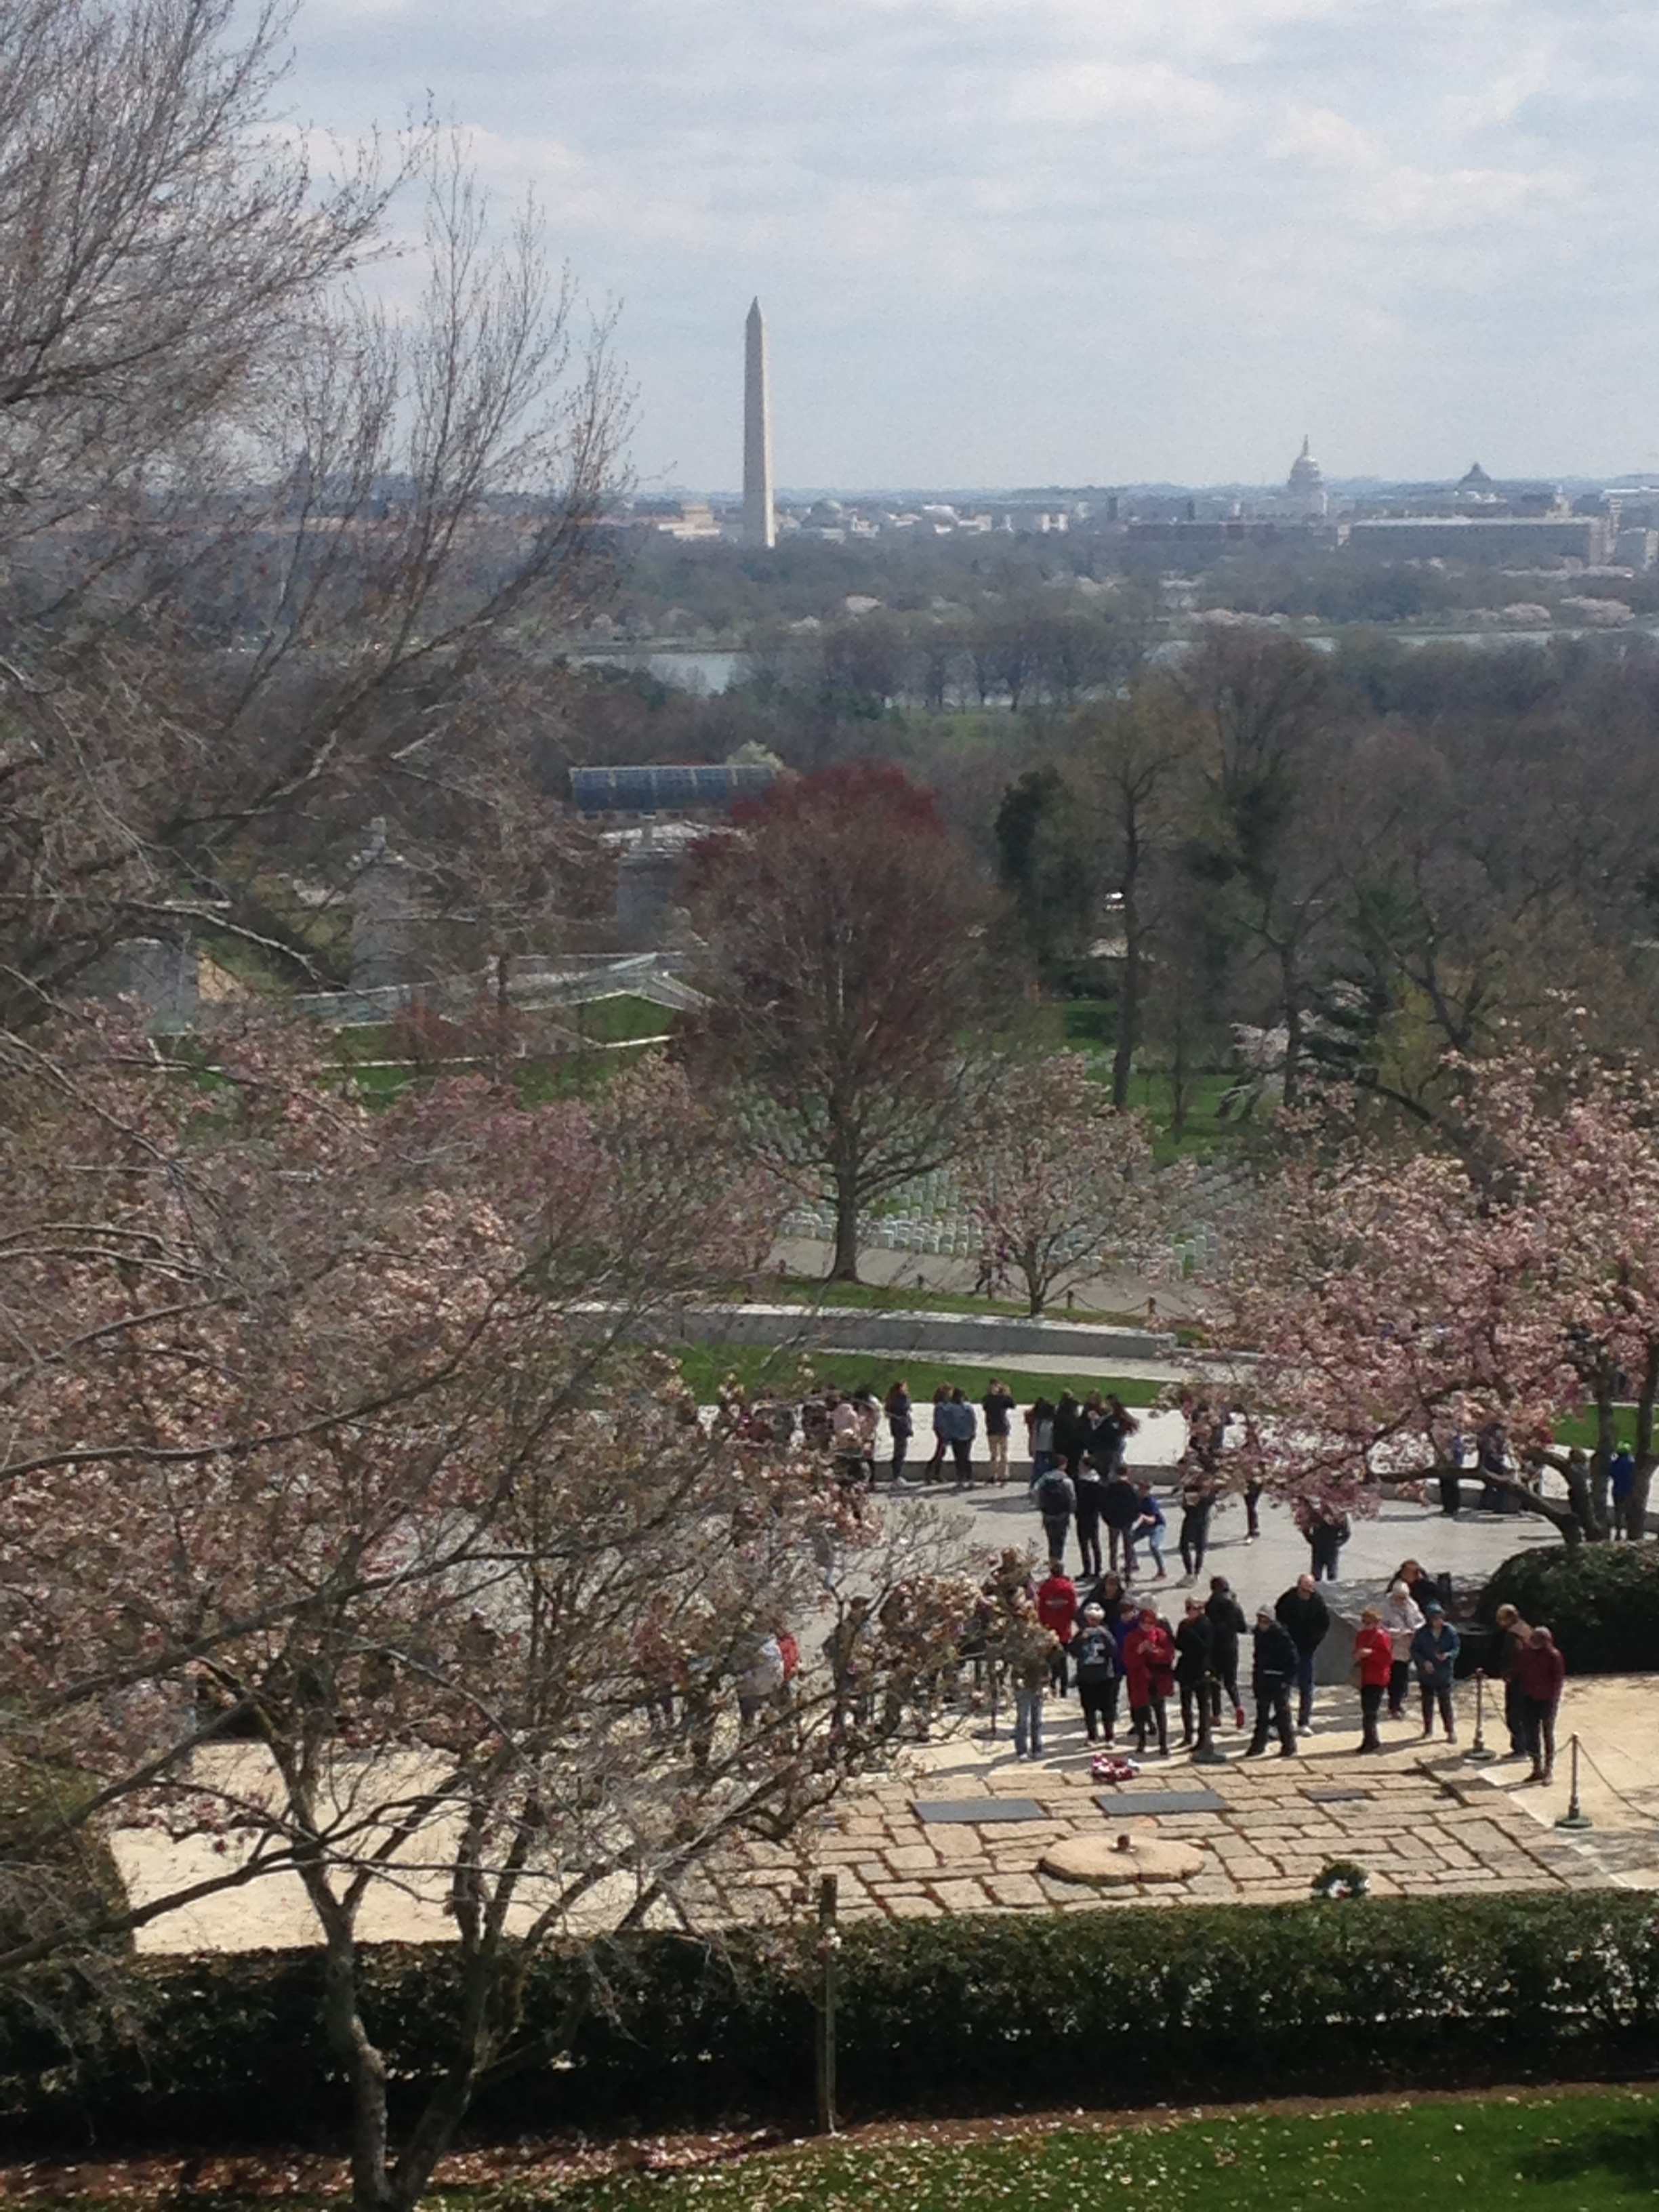
The Study Area Monuments of Washington, DC seen from Arlington National Cemetery (VA)

Slide 7
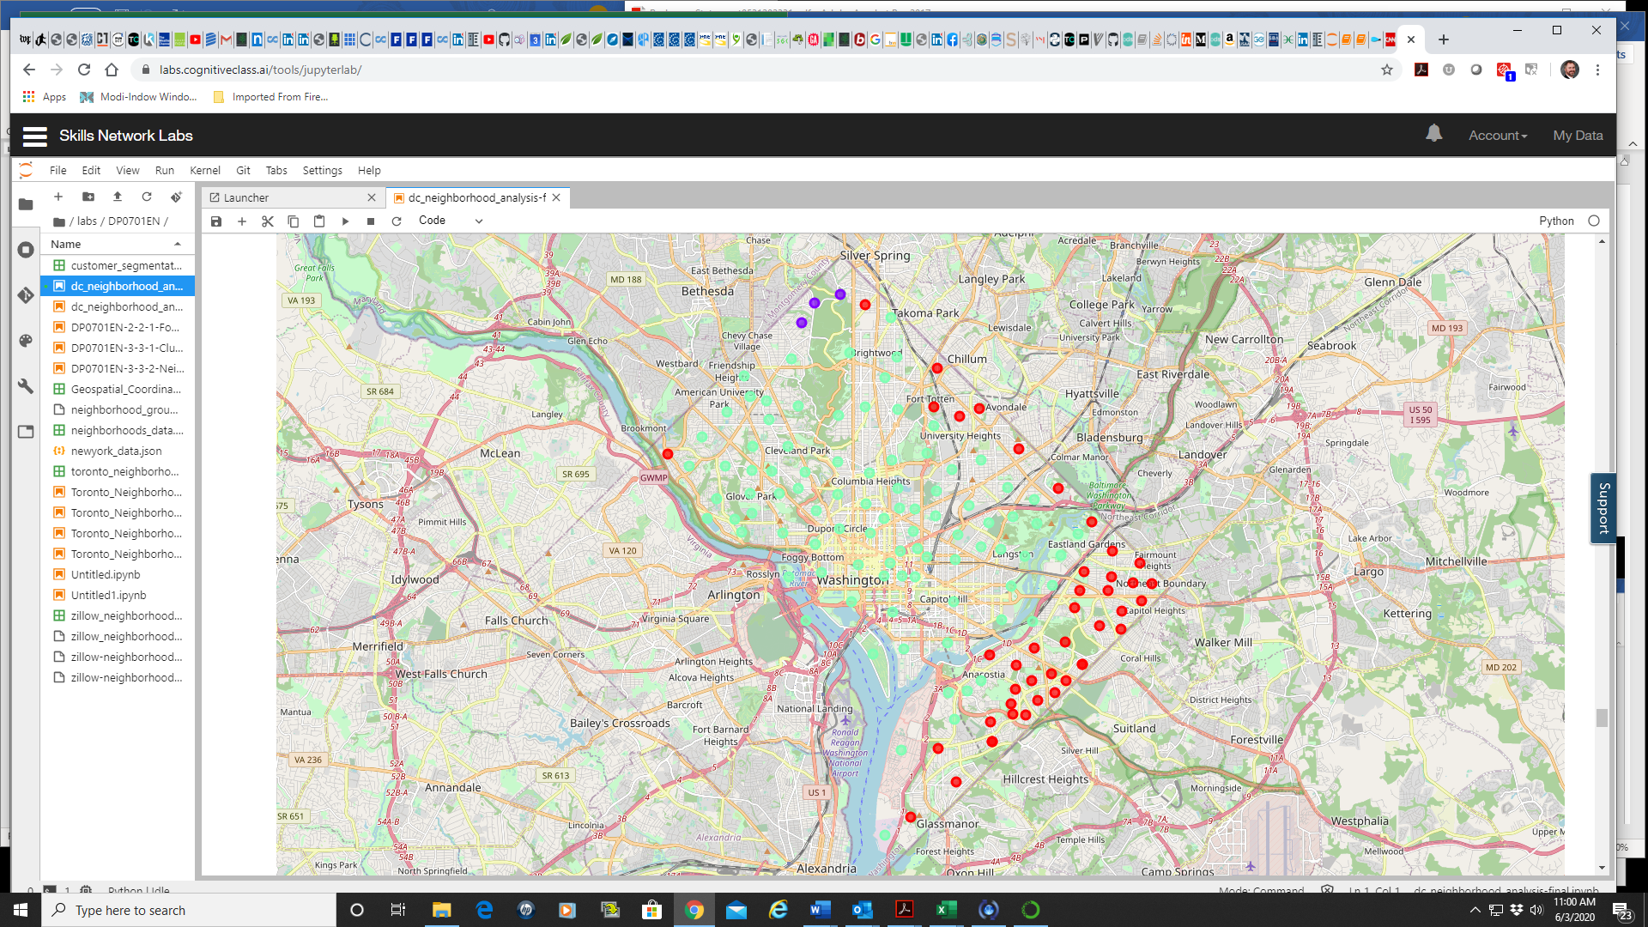
Search Parameters and Results
Foursquare search using a 1,000 m radius around the center of each neighborhood
135 neighborhoods
More than 6,600 venues
More than 340 unique categories
Pattern Identification – Use K-Means Clustering
3 clusters defined
More affluent
Less affluent
Heavy federal government presence

Slide 8
Results – 3 Clusters
1 very small (3 neighborhoods), adjacent to extensive parkland. Most common venue – trail!
1 large (91 neighborhoods), comprising the central business district and most areas to the west. Largely affluent and well-educated population.
1 moderate in size (41 neighborhoods), consisting of all areas east of the Anacostia River and several more on the northeaste periphery of the city (and one outlier on the west side).
What distinguishes the neighborhoods in the latter two clusters?

Slide 9
A Closer Look
Most Common Venues in DC Neighborhoods Across Two Large Clusters
Venue Category | Affluent Neighborhoods (n = 91) |  |  | Less Affluent Neighborhoods (n = 41)
 | Number of Neighborhoods |  |  | Number of Neighborhoods
 | Most Common | 2nd Most Common | Third Most Common | Most Common | 2nd Most Common | Third Most Common
Restaurant | 6 | 16 | 14 | 3 | 2 | 6
Coffee Shop | 16 | 11
Park | 8 | 7 | 9 | 4 | 5
Bank
Hotel | 7 | 6 | 6
Bar |  | 6 | 5
Bus Stop |  | 4
Intersection |  |  |  | 3 | 3 | 5
Carry Out |  |  |  |  | 2
Convenience Store |  |  |  | 8 | 15 | 6
Liquor Store | 6 |  |  | 10 | 4 | 3

Slide 10
A Closer Look
Many neighborhoods in both of the larger clusters offer access to parks and other similar green space
More affluent neighborhoods often have…
Coffee shops
Restaurants
Hotels and bars
In less affluent neighborhoods, the most common venues are often…
Convenience stores
Liquor stores

Slide 11
Discussion and Limitations
These preliminary results suggest differences in access to amenities that promote or detract from the health and well-being of Washington, DC residents based upon where they live
The Anacostia River appears to be meaningful dividing line
The expected “federal” cluster did not materialize. This may be due to large amounts of new residential construction and population growth downtown and in the areas north of most federal buildings.
Limitations
The “Starbucks effect:” the large number of coffee shops and restaurants in many neighborhoods may be obscuring the presence of other key venue types (e.g., grocery stores). A more detailed analysis using more tightly defined venue categories may be warranted.
This initial analysis was limited to a “first cut” at the presence of different types of amenities at the neighborhood level and was exploratory in nature. Making some refinements to this analysis and integrating racial, economic, and educational characteristics of resident populations could bring some added sophistication and potential value to the preliminary analysis presented here.

Slide 12



Thank You
Peter Soyka
petersoyka2@gmail.com

